Slide 1
Lesson 5: Mathematical Models of Electrical Control System Components
EC311
Linear Control Systems

Slide 2
Learning Objectives
After this presentation you will be able to:
Identify types of subsystems found in control systems.
List the characteristics of electrical subsystems.
Write mathematical models for electrical characteristics.
Solve for steady-state electrical quantities using given mathematical modeling equations.

Slide 3
Component Models
Subsystem types found in controls systems
Electrical
Motors, Solenoids, Transducers, Control Electronics
Mechanical
Control Valves, Gear Boxes, Linkages
Liquid Flow
Piping , Tanks, Pumps, Compressors, Filters
Gas Flow
Thermal
Heating Elements, Heat Exchangers, Insulation,

Slide 4
Component Models
Systems’ behavior defined by component characteristics
Example: electrical components
Resistance
Voltage
Capacitance
Current
Inductance
Charge
Delay

Slide 5
Component Models
Definition of Electrical Quantities
Resistance
Capacitance
Inductance
Delay
Amount of potential difference required to produce a unit of current.
Amount of charge required to make a unit change in potential.
Amount of potential required to make a unit change in rate of flow (current).
Time interval between signal appearing on input and response appearing on output.

Slide 6
Electrical Component Models
Resistance
Static resistance (linear)
Ohm’s Law
Dynamic Resistance (non-linear) Depends on the values of e and i.
Can estimate dynamic R with slope of tangent line at operating point.

Slide 7
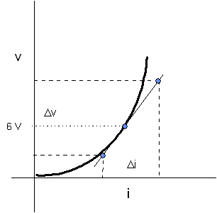
Electrical Component Models
Example 5-1: Non-linear resistance Volt-amp characteristic. Estimate dynamic resistance at the 6V operating point.
V₂=6.05 V
V₁=5.95 V
I₁=0.500
I₂=0.504

Slide 8
Electrical Component Models
Capacitance
I is rate of change of flow
Coulombs/sec = Amp
From the definition of Capacitance
Multiple by Δe
Divide by Δt
Definition of C
Where: V_{c} =e= voltage across capacitor
C = capacitance in Farads
i = capacitor current in amps

Slide 9
Electrical Component Models
Example 5-2: Sine voltage with amplitude V_{m} and frequency ω is applied across a capacitor with a value of C Farads. What is the capacitor current?
90 degree lead between current and voltage. Same as with phasors

Slide 10
Electrical Component Models
Example 5-3: Current pulse of 0.1 sec and amplitude of 0.1 mA is applied to a capacitor. It produces a rise in voltage from 0 to 25 V. What is the capacitance?
Use the incremental definition of C and solve for the value
V_{c1}=0 V V_{c2}=25 V
t₁=0 sec t₂=0.1 sec
i=0.1 mA=0.0001 A
ANS

Slide 11
Electrical Component Models
Inductance
Potential required to make change in current
Dead-time Delay
Where: D = distance (m)
v_{p} = velocity of propagation (m/s)
Use in high frequency transmission lines and satellite communications

Slide 12
Electrical Component Models
Example 5-4: A voltage pulse of amplitude 5 V with a duration of 0.02 seconds is applied across an inductor. This causes a current increase from 1 amp to 2.1 amp. Find L.
Use the incremental definition of L and solve for the value
i₁=1 A i₂=2.1 A
t₁=0 sec t₂=0.02 sec
e=5 V
ANS

Slide 13
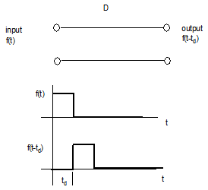
Electrical Delay Examples
Example 5-5
Electrical delays common in long high frequency transmission lines and satellite communications
Where v_{p} = velocity of propagation
typical values between
2-3 x10⁸ m/s
D = distance (m)
a.) Find the delay of a 600 m transmission line with v_{p} = 2.3x10⁸ m/s
b.) Find the delay of a satellite transmission with a path length of 2000 km and propagation velocity of
3x10⁸ m/s.

Slide 14
Electrical Delay Examples
a.) Find the delay of a 600 m transmission line with
v_{p} = 2.3x10⁸ m/s
ANS
b.) Find the delay of a satellite transmission with a path length of 2000 km and propagation velocity of 3x10⁸ m/s.
Convert km to m
ANS

Slide 15
END Lesson 5: Mathematical Models of Electrical Components
EC311
Linear Control Systems

